Slide 1
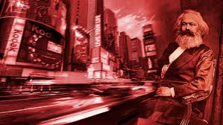
Marxism

Slide 2
Marxism and Literature
Texts have been used to support/legitimize the power of the ruling class (promote an ideology)
Must question if a text is an accurate representation of the social reality
Texts are analyzed in terms of where the power/money lies (bourgeois, white collar, working class etc…)
Looks for the tensions between classes (dominant and repressed) as basic economic organization changes

Slide 3
Bourgeoisie vs. Proletariat
The bourgeoisie or capitalists are the owners of capital, purchasing and exploiting labor power, using the surplus value from employment of this labor power to accumulate or expand their capital.
The proletariat are owners of labor power with no other resources than the ability to work with their hands, bodies, and minds.

Slide 4
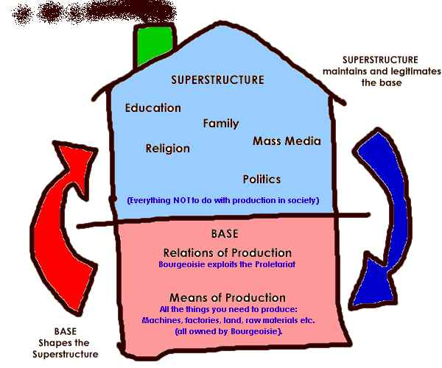

Slide 5
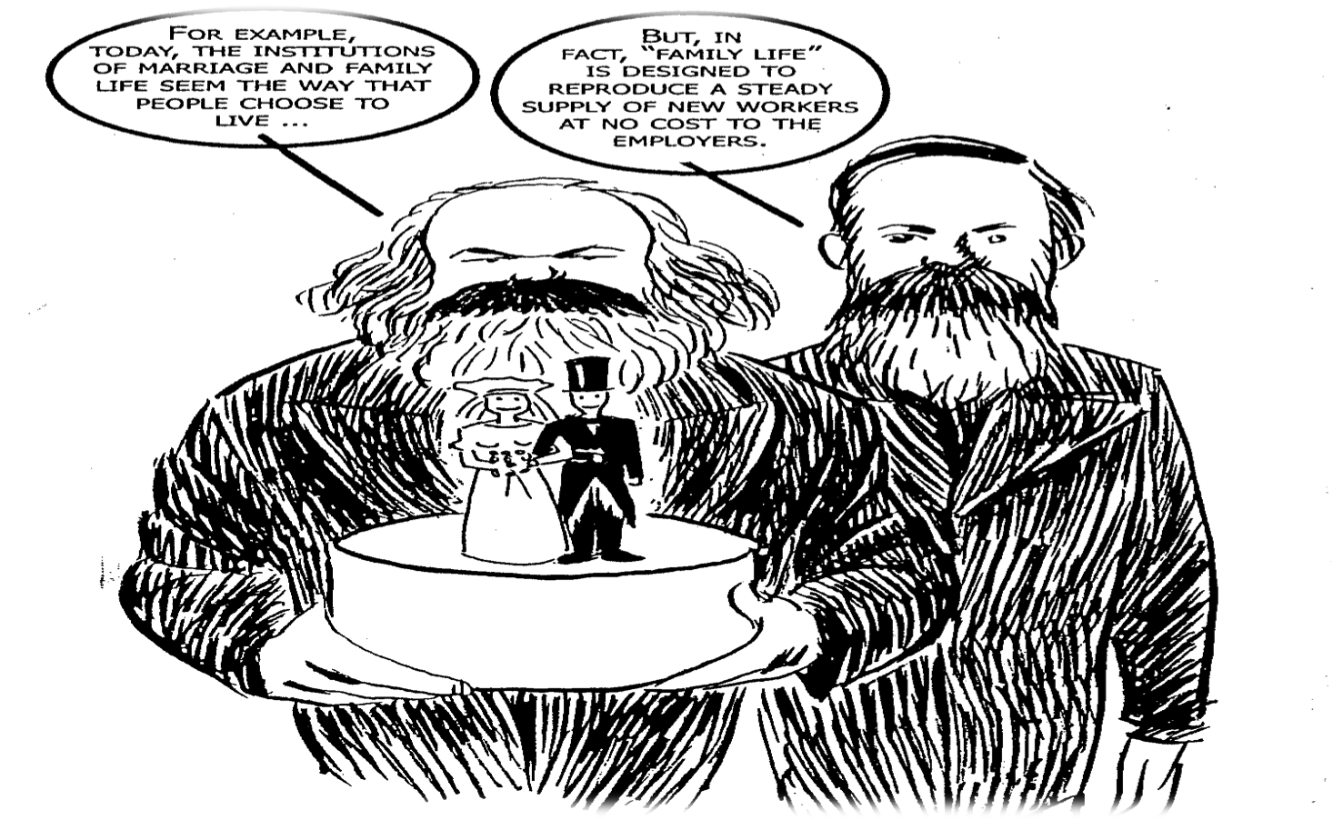
Substructure and Superstructure

Slide 6
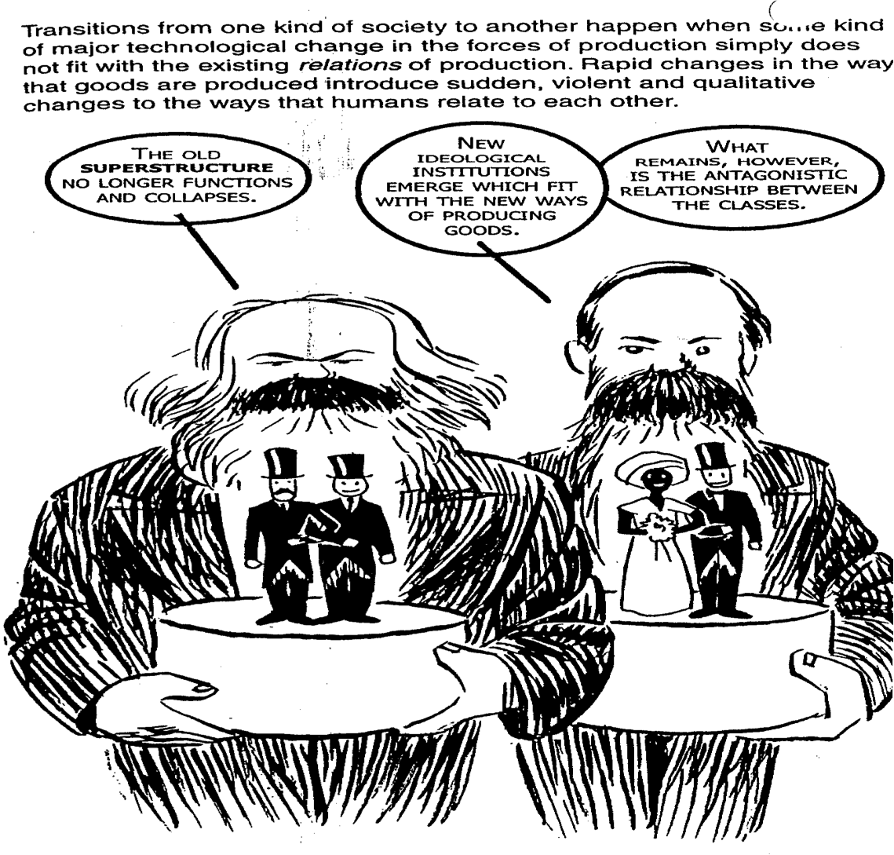
Substructure and Superstructure
Transitions from one kind of society to another happens when some kind of major technological change in the forces of production simply does not fit with the existing relations of production.

Slide 7
Understanding Alienation
Most humans have to live in conditions that make un-alienated, proper relations to life itself impossible. Instead of being a joy and a pleasure, work becomes boring drudgery. We only really feel free in the functions we share with animals- sex, drinking, eating, pleasure. Going on holiday seems to be the only time we are really human and alive. All this leads to a kind of self-alienation.

Slide 8
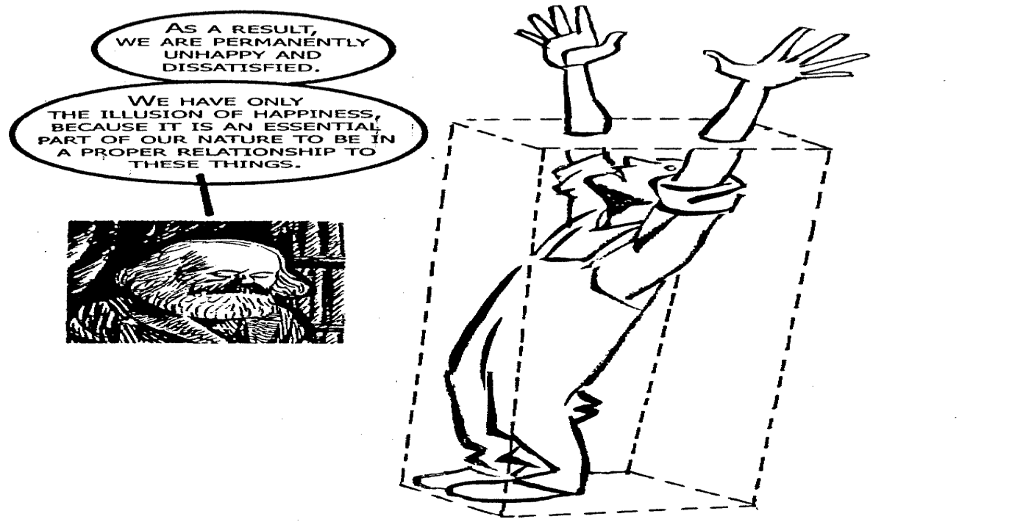
Consciousness of Alienation
The working class proletariat have been alienated through out the capitalist reign without being aware of it.

Slide 9
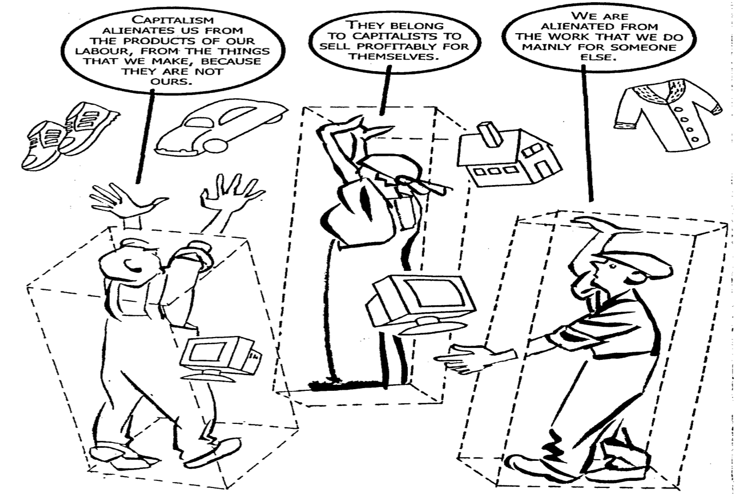
The Nature of Alienation: Reification
Reification is linked to alienation of people from work and their treatment as objects of manipulation than human beings.

Slide 10
Nature of Alienation
We are alienated from each other because the productive process of capitalism requires the superstructure of ideas to distort the natural cooperative way we should relate to other people.
For example, capitalism puts worker engaged worker by installing the idea that they are in competition for the same work. We are also alienated from ourselves as a species; this is the most fundamental kind of alienation.

Slide 11
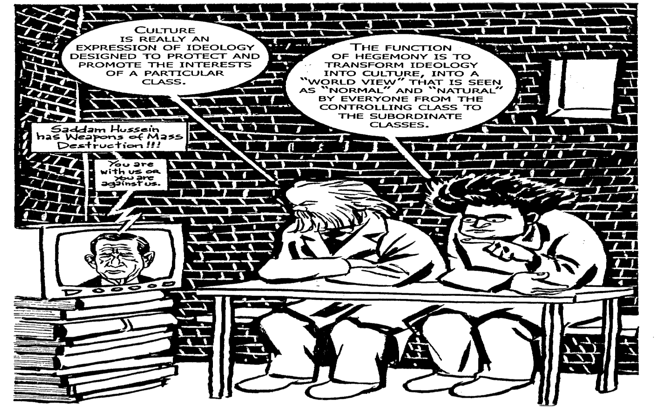
Culture, Ideology and Hegemony
Culture is usually taken to mean the whole set of attitudes, values and norms that bind a particular society together into a working unit. However, according to Marx, to see this in a normally neutral way is mistaken.

Slide 12
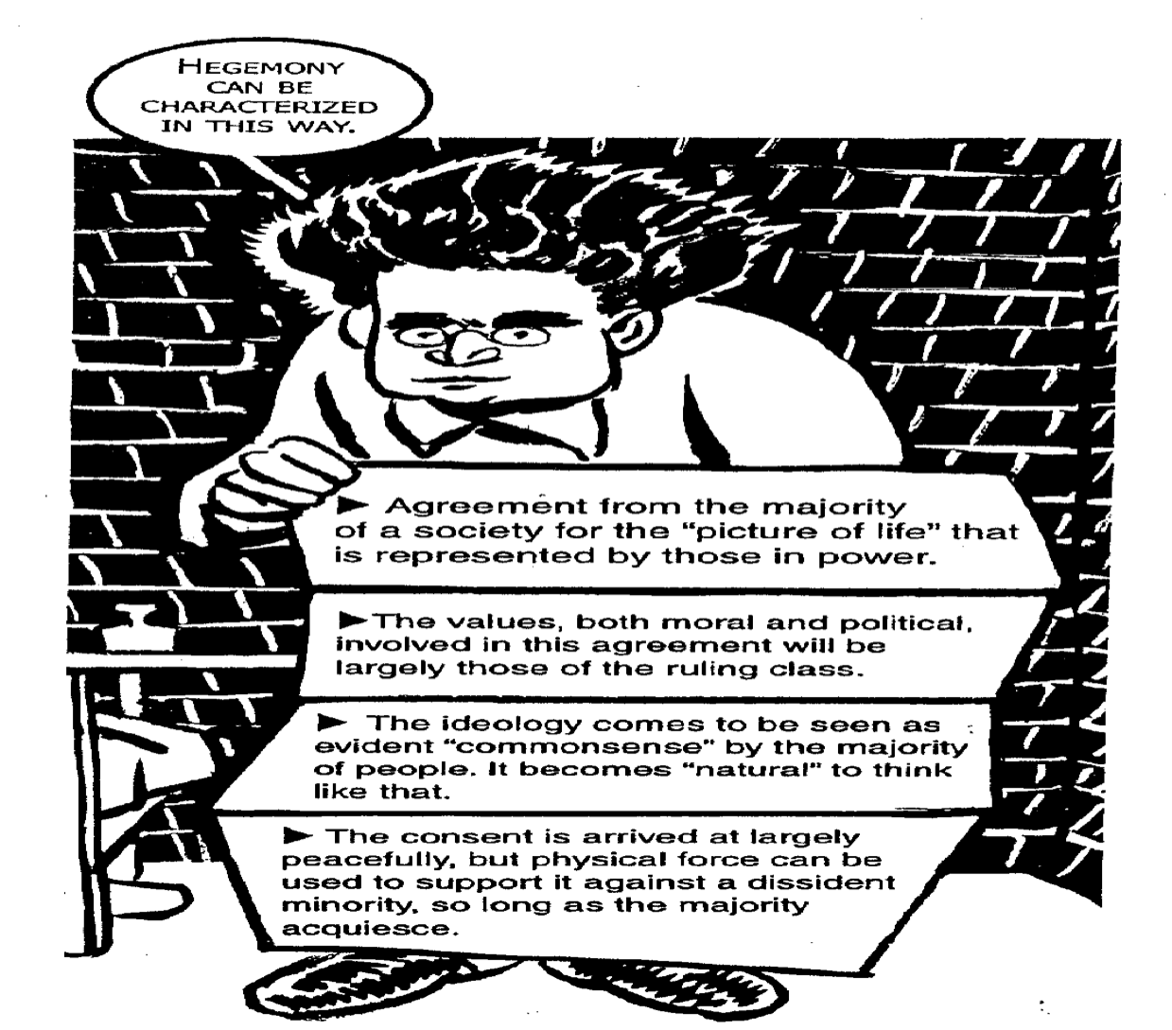
Hegemony

Slide 13
Hegemony
Hegemony changes over time as it re-adjusts to changing circumstances. It is the product of a kind negotiation between the dominant and the controlled class over what the latter will accept to believe and what they will not swallow.

Slide 14
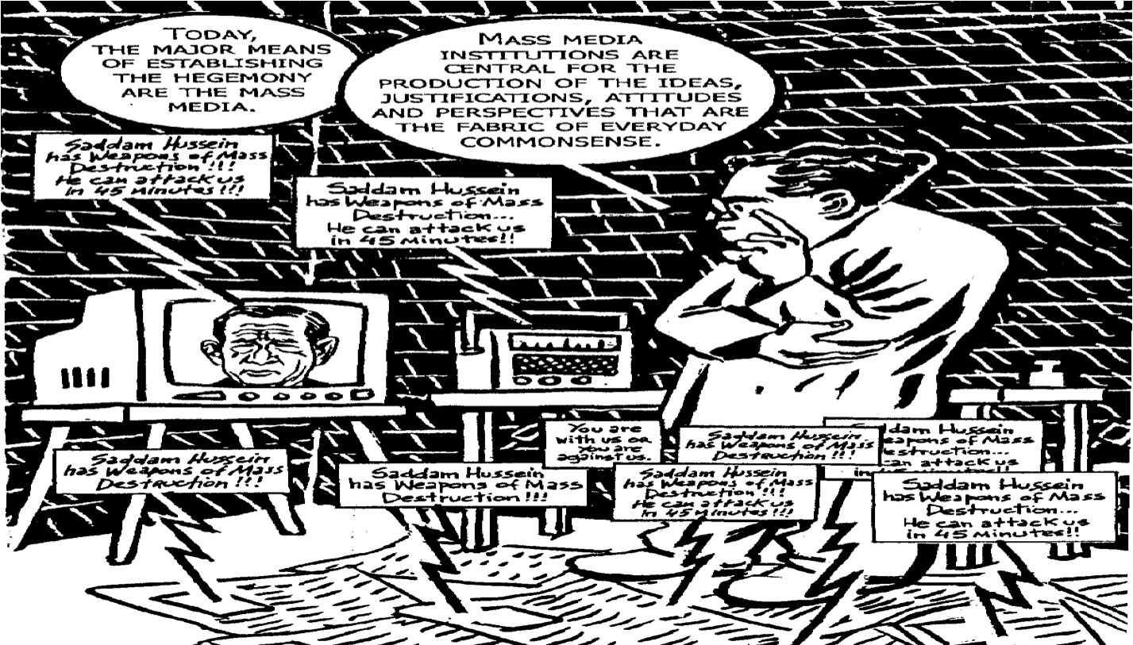
Key Institutions for establishing Hegemony: Church, Mass media, Education System

Slide 15
Ideology
For Marxism an ideology is a belief system all belief systems are products of cultural conditioning. For example, capitalism, communism, Marxism, religion, ethical systems, humanism, environmentalism.

Slide 16
The Role of Ideology
Undesirable ideologies promote repressive political agendas and in order to ensure their acceptance among citizenry passed themselves off as the natural ways of seeing the world instead of acknowledging themselves as ideologies.

Slide 17
Example
“It is natural for men to hold leadership positions because their biological superiority renders them more physically, intellectually and emotionally capable than women” is this sexist ideology that sells itself as a function of nature rather as a product of cultural belief.

Slide 18
Example
“every family wants to its own home on its own land” is a capitalist ideology that sells itself as natural by pointing the fact that almost all Americans want to own their own property without acknowledging that this desire is created in us by the capitalist culture in which we live.

Slide 19
Some ideologies
Consumerism:
Ideology that says I am only as good as what I buy. It gives the illusion that I can be as good as the wealthy if I can purchase what they purchase.
Religion:
It helps to keep the poor satisfied with their lot in life, or at least tolerant of it much as a tranquilizer might do. The question of God’s existence is not the issue for Marxist but what human beings do in God’s name organized religion is the focus.

Slide 20
Some ideologies
Patriotism:
It keeps Poor people finding wars against poor people from other countries while the rich on both sides rake in the profits of wartime economy.
Classism:
It equates one’s value as a human being with the social class to which one belongs. The higher the social class, the better one is assumed to be because quality is in the blood, that is inborn.
People at the bottom of the social scale are naturally lazy and irresponsible; therefore, it is natural and right for those from the highest social class to hold all the positions of power and leadership.

Slide 21
Literature
It is a product of the socio-economic and ideological conditions of the time and place in which it was written whether or not the author intended so. Because human beings are themselves products of their socio-economic and ideological environment. It is assumed that authors cannot help but create works that embody ideology in some form.

Slide 22
Literature
The literary work might tend to reinforce in the reader the ideologies it embodies
It might invite the reader to criticize the ideologies it represents. Many text do both. It is not merely the contents of a literary work that carries ideology but the form as well. If content is the “What” of literature then form is the “How”.

Slide 23
Tension in Marxist literature
The struggle against injustice and oppression. Tension between races, classes, and genders.

Slide 24
Family
Family is the product of material/historical circumstances.
The family unconsciously carries out the cultural “program” in raising his children but that “program” is produced by the socioeconomic culture within which the family operates. While it is our parents who read us bedtime stories, take us to movies, form our morals, it is our social system that provides the stories, movies and morals which ultimately represent interests of those in control of that social system.

Slide 25
Questions Marxists ask about literary texts
Does the work reinforce, intentionally or not, capitalist, imperialist, classist values? If so, then the work maybe said to have a capitalist, imperialist or classist agenda and it is the critic’s job to expose and condemn this aspect of the work.

Slide 26
Questions Marxists ask about literary texts
2. How might the work be seen as a critique of capitalism, imperialism, or classism? That is, in what ways does the text reveal and invite us to condemn oppressive, socioeconomic forces?

Slide 27
Questions Marxists ask about literary texts
3. Does the work in some ways support the Marxist agenda in other ways, perhaps unintentionally, support a capitalist, imperialist, or classist agenda? In other words, is the work ideologically conflicted?
4. How does a literary work the reflect, intentionally or not, the socioeconomic conditions all the time in which it was written and for the time in which it is set and what do those conditions reveal about the history of class struggle?

Slide 28
Questions Marxists ask about literary texts
5. How might the literary work be seen as a critique of organized religion? That is, how does religion function in the text to keep the character, or characters from realizing and resisting socioeconomic oppression?

Slide 29
The Nightingale and the Rose
Nightingale
Red Rose
Oak Tree
Professor’s daughter
Chamberlain’s son
Student

